Slide 1
One Ink System: The Next Level of Efficiency

Slide 2
Flexo Efficiency – Ink makers perspective
Presentation Overview
High Speed printing
Multi color process printing
One ink system for all end uses, including lamination and surface

Slide 3

Increased Efficiencies in the Flexo Process
For the past few years, the flexo industry has been discussing ways to increase the efficiency of the flexo printing process:
  The primary paths the industry has pursued:
    High Speed Printing
        Today we can define high speed printing as press speeds from 1700 – 2500 FPM

Slide 4
High Speed Inks
Design criteria:
  Ink drying speed
    As the press speeds increase, the ink drying speed needs to be slower
    More stable ink solvent blends to minimize change due to shear of high speed process
  Ink re-solubility
    With the high press speeds, ink will dry on plates and aniloxes
    The ink needs to be resoluble to minimize the defects
  Ink needs to be stronger in color
    Important as the stronger color will allow thinner ink films, which will minimize defects such as misting

Slide 5

Increased Efficiencies in the Flexo Process
For the past few years, the flexo industry has been discussing ways to increase the efficiency of the flexo printing process
The two primary paths the industry has pursued:
  High Speed Printing
  Use of Multi-Color Process Printing (typically 7-color)

Slide 6
Multi-Color Process Printing
Multi-color process printing (a.k.a. 7-color, ECG..)
  Well accepted by the flexo industry
  Process continues to be refined with both pre-press and converting
  New plate and ink technologies have been introduced in the market to support this increased efficiency
  Benefits are well understood
    Less down time for color matching
    Less down time for clean up on job change over
    Less waste
    All adding up to better efficiencies in the press room

Slide 7
One Ink System: The Next Level of Efficiency
What’s next….how can we continue to innovate to improve the efficiency of the pressroom?
Maybe the best way to determine this, what is causing the down time where the printing press is not running?
  Structure, film, ink, specs change from job to job
    Meaning, due to the change in package requirements from:
      Film to film
      Surface printing requirements to lamination printing requirements
      Different bond requirements, different surface rub characteristics

Slide 8

One Ink System: The Next Level of Efficiency
What if---
  We truly had a multi-purpose ink?
  Defined as:
    Runs surface and reverse (same ink)
      Will laminate
      But have the resistance properties needed for a surface print application
    Multi-film
      Handles all the common lamination and surface films
    Compatible with solvent-less, solvent and water based adhesives

Slide 9
Performance Attributes: Introducing SunUno Solimax
Suitability
Flexo
Surface Print
Mid performance lamination
Compatible with both Solvent free & solvent based lamination technologies
Applications:
Lidding material
Confectionary
Snack Food
Dried Foods
Pouches
Substrates
OPP
OPA (nylon)
PET
PE
Selected Coated Films
Development of a multi-purpose (both surface & lamination), introducing a multi-film ink system – SunUno Solimax

Slide 10
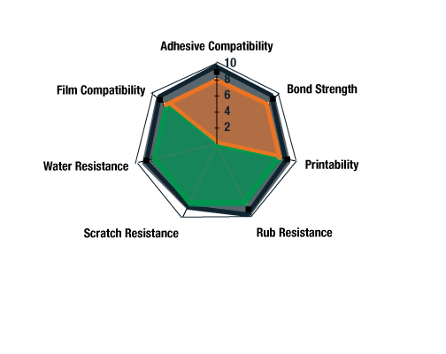
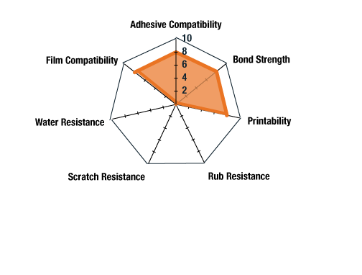
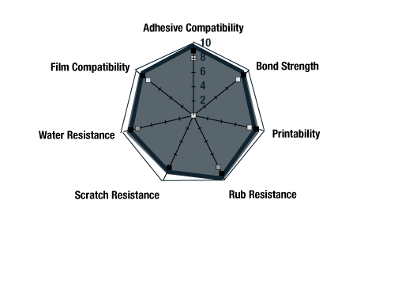
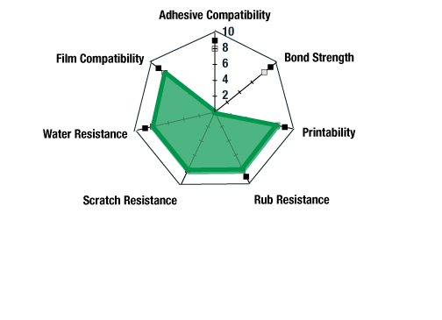
One Ink System: The Next Level of Efficiency
Lamination
Surface
Multi-Purpose
Lamination
Surface
Multi-Purpose

Slide 11
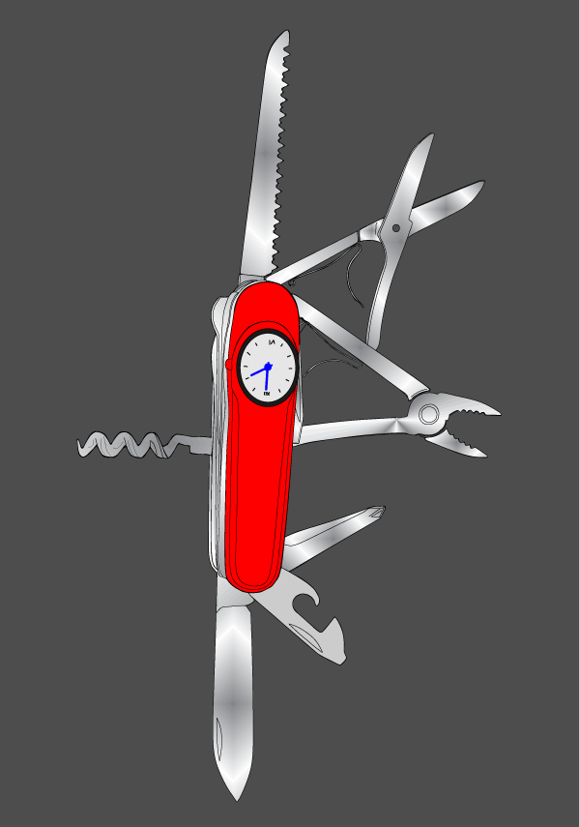
What are the benefits of a multi-purpose ink system?
One single ink system that allows both lamination & surface printing
Reduce:
  Converter waste
  Converter downtime
  Complexity
  Inventory

Slide 12
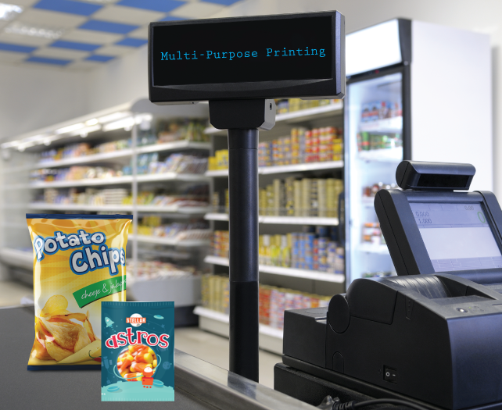
One Ink System: The Next Level of Efficiency
Questions?
Contact Sun Chemical:
Email: naimarketing@sunchemical.com
Telephone:
708.236.798

